Slide 1

Puzzle Dots
Jeffrey Petersen - Product Owner,
Vanda Pandhumsoporn,
Connor Dunham,
Adam Henry

Slide 2
Puzzle Dots Preamble
A puzzle game written in C++ about directing the behavior of dots. Game offers short levels with varying complexity and replayability through finding improved solutions.

Slide 3
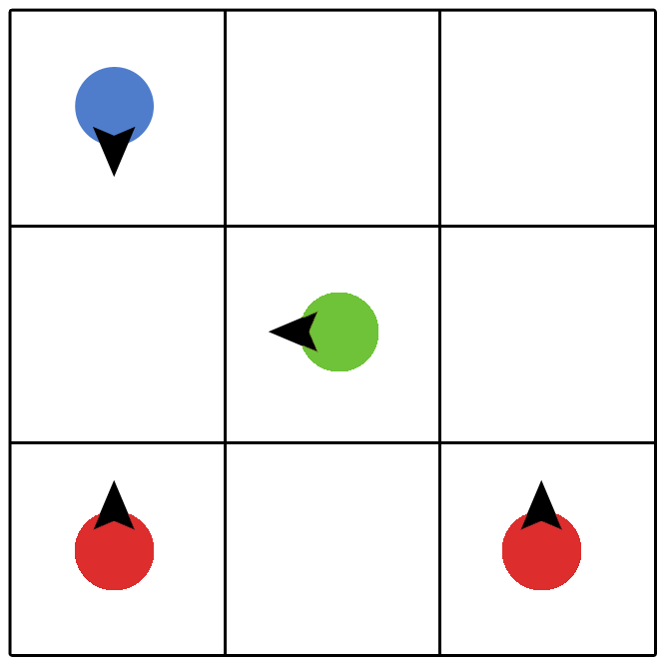
Puzzle Dots Game Concept
Pieces move in different directions.
Players strike two compatible pieces to combine them into a new piece.
Forming a new piece through gameplay is called a reaction.
Via experimentation, a player learns new combinations.
The goal is to bring all pieces into their designated squares.

Slide 4
Project Release Plan - User Stories
Puzzle Dots
Sprint 1
(5 SP) As a player, I want to play a basic level so I can have fun.
High level goal: Level Progression
(3 SP) As a player, I need guidance on how to play so I can learn the controls.
HLG: Test driven code implementation (Game playtesting, concept and application) and get feedback
(2 SP) User Story 1: As a product owner, I need to set up an integration system for the team so we can collaborate.
HLG: Continuous integration using Git.
(8 SP) User Story 2: As a product owner, I want to prototype the game and so I can learn about user interaction.
HLG: Prototype testing

Slide 5
Project Release Plan - User Stories
Puzzle Dots
Sprint 2
(1 SP) As a player I want to see how many moves it took to complete a level so I can compare my score with other players.
HLG: Test driven code implementation (Game playtesting, concept and application)
(8 SP) As a player I want a progression of levels that teach me how to play the game and become more challenging as I progress.
HLG: Level progression Sprint 3
(5 SP) As a player, I want an addicting game that saves my play state so I can return to it later.
HLG: Test driven code implementation (Game playtesting, concept and application)
(8 SP) As a player, I want to be able to play this game on my phone or tablet so I can play on the go.
HLG: Available to play games on different platforms
(3 SP) As a player, I want the puzzles to show solutions so that when I am stumped I can continue to the next level.
HLG: Get feedback and suggestions from users/players

